Slide 1


Empowering Global Fintech Success: Implementing Fineract Across Borders
Cecilia Menso
Head of Delivery at Fiter
Notes:
Who am I?
Delivery Lead of Fiter. Started as PM for Latam, role evolved to overseeing projects world wide.
Mom of 2, wife of 1.
=

Slide 2
Table of Contents
Fineract
Real-world Case Studies
  What is it and why adopting its use?
  Features overview.
  Non-profit Social Enterprise - Regulated Bank
  Fintech
Global Implementation Journey
Key takeaways and lessons learned
  Project lifecycle.
  Customizations across the globe.
  Review
Challenges in Global Implementations
Q&A
  Overview
  How to overcome them

Slide 3
Fineract

Slide 4
  What is Fineract?
  Fineract is an open-source software platform that provides reliable, cost-effective core banking services for traditional financial institutions and FinTechs.
  Why is Fineract important for fintech?
  It enables digital financial services, promoting financial inclusion and scalability for FinTechs globally.
  It’s main benefit? Flexibility.
Notes:
Flexibility regarding possibility for development based on clients needs and budget, allow them growth with peace of mind.

Slide 5
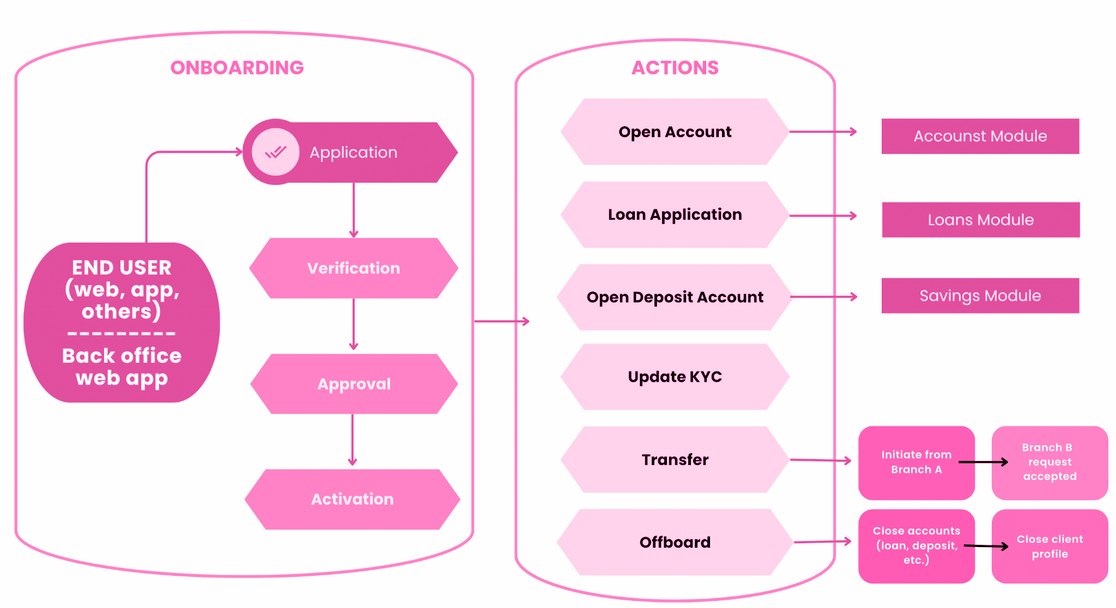
Apache Fineract features
System Administration
Audit Trail.
Roles & Permissions.
Maker & Checker.
Scheduler jobs.
Webhooks.
Configurations.
2FA.
Organization Administration
Manage Holidays/Working days.
Manage Employees/Offices.
Configure loan provision.
Currency configurations.
Cashier management.
Bulk import.
Reporting
+30 reports
Clients
Savings & Deposits
Accounting

Slide 6
The Global Implementation
Journey
Notes:
(the magic on how we do it will not be revealed at this time…)

Slide 7




Project lifecycle
1. Requirements gathering & gap analysis.
2. Implementation
design
4. Deployment
& Go-live
3. Development
& QA
Notes:
In simple terms

Slide 8
Fineract customizations across the globe
Revolving credit.
EODO/Reconciliation
Cashier Module
Checks generation and processing.
Foreign exchange module.
Interests and charges matrix for application based on client parameters.
Transactional & historical logs
VAT/CAT calculation.
Terms translation based on country (spanish)
Part Loan Liquidation
Birt Reporting
Cluster loans exchange inbuilt
Min/Max charge amount
FD topup/ partial liquidation/ forex
Asynchronous report generation
CBN report
NUBAN generation
Odoo integration.
Cluster loans exchange inbuilt.
Default reporting under Postgres.
Integrations:
  CRM and ERP
  Regulatory reporting.
  Azure Blob Storage integration.
  Regulatory reporting.
  Bureaus and risk management.
  Decision engines.
Notes:
Fineract's Global Reach:
- Fineract is used by diverse fintech clients worldwide, from large banks to small NGOs.
Projects I’ve supported span across various regions, reaching clients in different parts of the world.

Slide 9
Challenges in Global Fineract Implementations

Slide 10
Challenges in Global Fineract Implementations
Regulatory
Variations
Cultural
Differences
Varying financial regulations and compliance requirement.
Nuances and language barriers.
Localized Customization
Scalability
To handle growth and increased transaction volumes.
To accommodate local financial products and services
Data
Security
Compliance with international data protection laws is crucial.
Notes:
Regulatory Variations: being ready to respond quickly once regulation introduces a change.
Cultural differences: a

Slide 11
Real-world Case Studies

Slide 12
Real-world Case Studies
Non-profit Social Enterprise
Regulated Bank
Fintech
Location: Guatemala
Location: Nigeria
Location: Colombia
Their philosophy is to offer financial products 100% digitally, easy, and fast manner to individuals who are seeking credit with the aim of progressing.
+700k clients since its go live in 2020.
LMS based on Colombia’s regulation.
  Local taxes/charges (IVA/CAT)
Massive interest and charges waiver.
Partial interest and charges waiver per amount.
Integration with invoicing vendor.
Their mission is to create opportunities that empower Guatemalan women to build a better life.
Digitalize and automate end to end process, previously handled ‘in paper’:
Specific loan management for group/communal lending.
Black listed clients management.
Group qualifications based on parameters.
Extensive loan analysis and approval workflows.
Checks generation and management.
Their mission is to help Nigerians fulfil their potential by democratizing access to valuable solutions for their business and personal needs.
+190K clients since it’s go live in 2019.
Digital bank running fully on Fineract.
Account Opening & Savings
Analyse your expenses and categorise your finances
Send & Request Money and Bills Payments made easy.
Debit Card integration

Slide 13
Key takeaways and lessons learned

Slide 14





Key takeaways and lessons learned
Wide adoption
Getting local insights
Widespread adoption underscores the platform's flexibility and applicability to diverse financial scenarios. Potential is unlimited.
The necessity of having insights into local markets and financial environments.
Room for improvement
Community oriented development
Data migration, integrations, use of AI to become more effective and accurate while building on top of Fineract.
Focus on quality and reliability.
Fostering acceleration of development.
Contributing for global reach and adoption.

Slide 15
Questions?

Slide 16
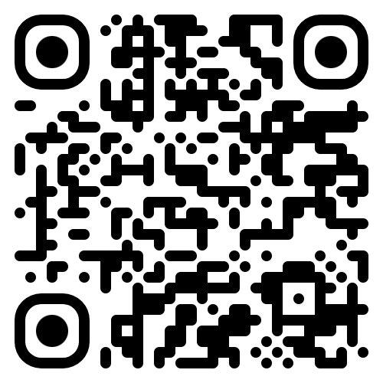
Thank you!

